Slide 1

Hashing
Bloom Filters
Robert Tang - Soham Pardeshi - Ben Fong - Samantha Seymour

Slide 2
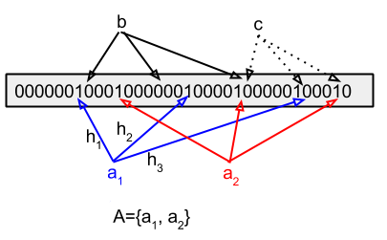
Brief Definition
According to source, “A Bloom filter is a space efficient probabilistic data structure, conceived by Burton Howard Bloom in 1970, that is used to test whether an element is a member of a set.”
Bloom Filter is a set, it only use for test whether an element is in the set or not. It does not store the element.

Slide 3
Algorithm
template <class K>
class BloomFilter {
private:
bool *table; // BitSet
int n = 34950; // the number of elements
int k = 3; // number of hash functions
const int m = n * k;
int num; // number of entries
public:
BloomFilter() // constructor
{
table = new bool[m];
for (int i = 0; i < m; i++)
{
table[i] = 0;
}
} // end func
void add(K key);
bool contains(K key);
Int hashFunc1(K& k);
Int hashFunc2(K& k);
Int hashFunc3(K& k);
};
To implement the Bloom Filter, we can declare a m length BitSet and initialize each slot to 0.
There must be k different Hash functions.
m = n * k; // the length of BitSet n = the number of elements k = the number of Hash functions
Big O(k), constant function

Slide 4
Implementation: Add
void BloomFilter<K>::add(K key) // insert
{
unsigned int hash1 = hashFunc1(key);
unsigned int hash2 = hashFunc2(key);
unsigned int hash3 = hashFunc3(key);
table[hash1] = 1;
table[hash2] = 1;
table[hash3] = 1;
}

Slide 5
Implementation: Contains/Check
bool BloomFilter<K>::contains(K key) // find entry with key k
{
unsigned int hash1 = hashFunc1(key);
unsigned int hash2 = hashFunc2(key);
unsigned int hash3 = hashFunc3(key);
if (table[hash1] == 1 && table[hash2] == 1 && table[hash3] == 1)
{
return true;
}
else
{
return false;
}
}

Slide 6
Hash Function #1
int BloomFilter<K>::hashFunc1(K& k) // hash function
{
int sum = 0;
int len = k.length();
int val;
for (int i = 0; i < len; i++)
{
val = k[i];
sum += (val + 3) * 7;
}
return (sum % m);
}

Slide 7
When Bloom Filters are Used
Allow errors Because hash can generate collisions, Bloom Filter only suitable for those scenarios that allow errors.
Big Data and Space Efficiency Because Bloom Filter doesn’t store the data of elements, so this would reduce the space 8 times comparing with other Data Structure.
Use Case
Filters of SPAM Email
Malicious URLs

Slide 8
When Bloom Filters are not Used
Error Free Bloom Filter does not suitable for those error-free scenarios.
Deletion Allow Bloom Filter doesn’t allow deletion

Slide 9
Thanks for watching

